Slide 1
Database
Revision
*
Notes:
‹#›

Slide 2
Relational Database Definitions
Database : a collection of tables
Table/Entity : a collection of records
Attribute/Column/Field: a Characteristic of an entity
Row/Record/Tuple : the specific characteristics of one entity

Slide 3
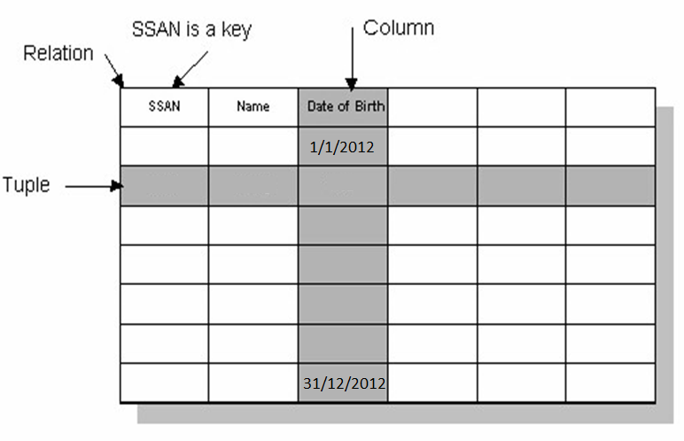
Relational Database

Slide 4
Relational Mapping(Schema) Steps
Step 0: Mapping 1-1 relationship mandatory from 2 sides
Step 1: Mapping of Regular (Strong) Entity Types
Step 2: Mapping of Weak Entity Types
Step 3: Mapping of Binary 1:1 Relation Types
Step 4: Mapping of Binary 1:N Relationship Types.
Step 5: Mapping of Binary M:N Relationship Types.
Step 6: Mapping of N-ary Relationship Types.
Step 7: Mapping of Unary Relationship.
Notes:
‹#›

Slide 5
Step 1: Mapping of Regular Entity Types
entity type with simple attributes
entity type with composite attribute
entity type with Multi-Valued attribute
entity type with Derived attribute
entity type with Complex attribute
Notes:
‹#›

Slide 6
Step 2: Mapping of Weak Entity Types
Create table for each weak entity.
Add foreign key that correspond to the owner entity type.
Primary key composed of:
Partial identifier of weak entity
Primary key of identifying relation (strong entity)
Notes:
‹#›

Slide 7
Mapping of Relationships :
1 - 1 => One Table , Choose PK of any entity to this table.
1 - 1 => 2 Tables , Take PK Of Optional As FK In Mandatory Table.
1 - 1 => 3 Tables , Choose PK of any entity to this table.
1 - M => 2 Tables , Take PK Of One As FK in Many
1 - M => 3 Tables , PK of Third Table is PK of Many
M - M => 3 Tables , PK of Third Table is Composite PK (PK1 + PK2)
Ternary => Table for Each Entity
+ Table for Relation Contains PKs of each table as FK
( PK is Composite PK).
Unary => recursive foreign key.
Notes:
‹#›

Slide 8
Database
SQL
(Structured Query Language)
*
Notes:
‹#›

Slide 9
Database Mapping
Schema
Database Implementation
Notes:
‹#›

Slide 10


Server:

Slide 11
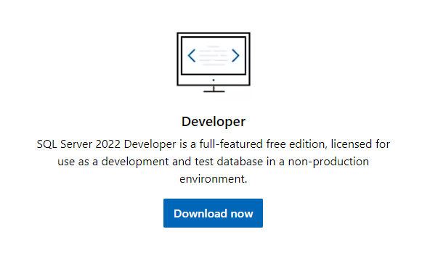
Download Sql Server Service

Slide 12
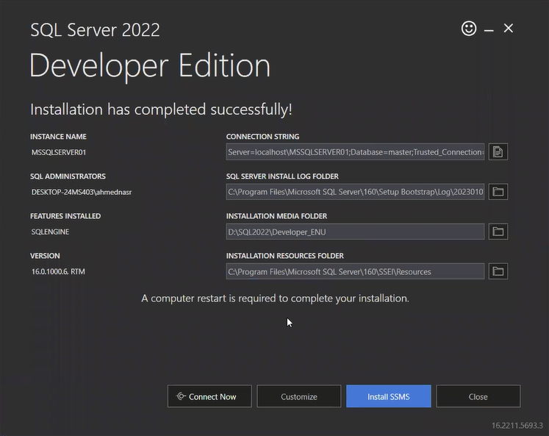
Download Sql Server Service

Slide 13
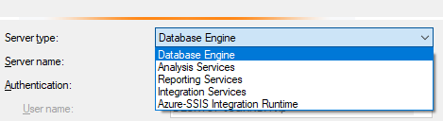

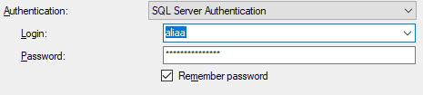
Server Types :
Authentication:
SQL Server Authentication:

Slide 14
Database files :
1- MDF ( Main Database File) : Contains all the information in a database like Data of creation , User who created it , Tables , Columns , Data types of columns …….
2- LDF ( Log Database File) : records all the transactions and changes to the database Except TRUNCATE TABLE statement

Slide 15
Comments
-- Single Line Comment
/*
MultiLine
Comment
*/
Note:
Ctrl+K , Ctrl+C => Comment
Ctrl+K , Ctrl+U => Uncomment

Slide 16
Data Types
Numeric Data Types
[bit , tinyint , smallint , int , bigint]
Fractions Data Types
[smallmoney , money , real , float , dec( , )]
Character and String Data Types
[char , varchar , nchar , nvarchar ,varchar(max),nvarchar(max)]
Date and Time Data Types
[date , time , time( ) ,smalldatetime , datetime , datetime2( ),datetimeoffset]
Binary Data Types
[binary , image , varbinary]
Miscellaneous data types
[Xml , sql_variant]

Slide 17
Variables
1. Global Variables
@@Version
@@ServerName
@@Langauge
@@Connections
@@Errors
2. Local Variables
declare @age int = 3
set @age = 55
print @age

Slide 18
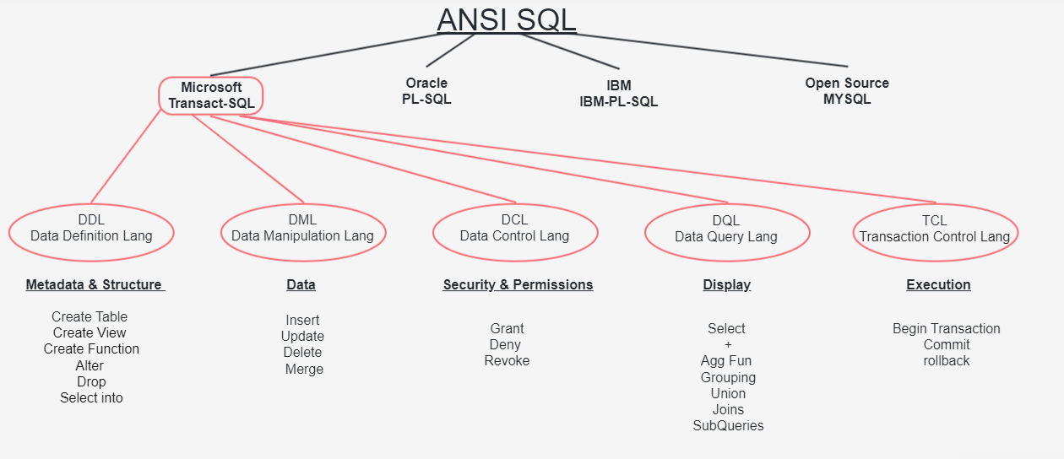
SQL Categories

Slide 19
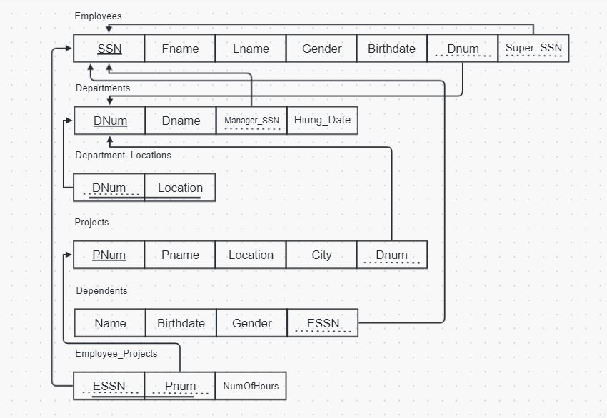
DDL Category - Create

Slide 20
DDL Category - Alter & Drop
Add => Alter Add
Update => ALter Alter
Delete => Alter Drop

Slide 21
DML Category
Insert :
Simple Insert => Insert Just Only One Row
Row Constructor Insert => Insert More Than One Row
Update
Delete

Slide 22
DQL Category - Select
Select all data
Select Specific Columns
Select Alias Name
Select + (Between , in , is null , Like)

